Slide 1

Diabetes Diiary
David Halek
CPSC 4900 – prof. Kato

Slide 2
Summary
The purpose of this application is to allow a user to keep track of information for diabetes.
- Date, time, and type of entry (Breakfast/Lunch/Dinner/Bedtime)
- Glucose value
- Dosage information for insulin
- Approximate carbs eaten
- Any notes about the food or in general

Slide 3
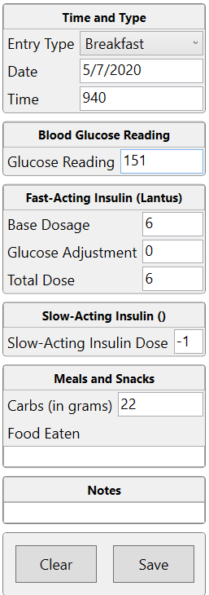
Info Entry
- Neil Armstrong
This allows entry of the information. Everything except for the entry type and date are optional, but should generally be filled in except for notes and food eaten.
Date will populate with today’s date if you click box and then leave it.

Slide 4
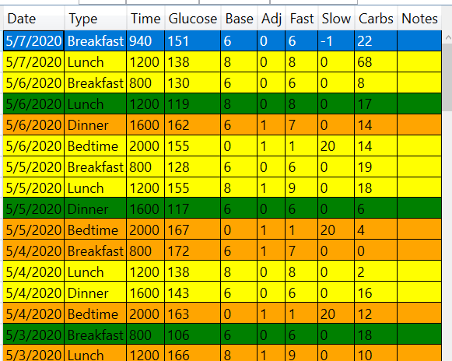
Entry Log
This shows the most recent entries that have been made. Default sorting is by date and then entry type, but it’s sortable on any columns.
Selecting an entry here will populate it in the entry form.
Colors are based on glucose levels. Red for very high/low, orange/yellow for medium, green for very good glucose levels.

Slide 5
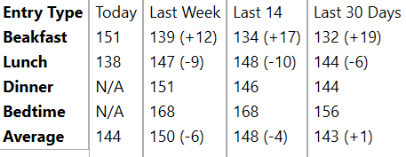
Recent History
This area shows the recent numbers – for the last week, two weeks, and month.
It will update upon entries being made or edited.
A popup box will also show the variances from recent numbers.
The first number will be the average glucose level for that time frame, the second in parenthesis is the variance (minus is good, plus is not so much)

Slide 6
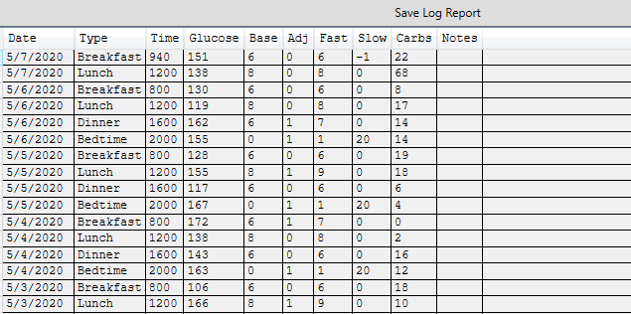
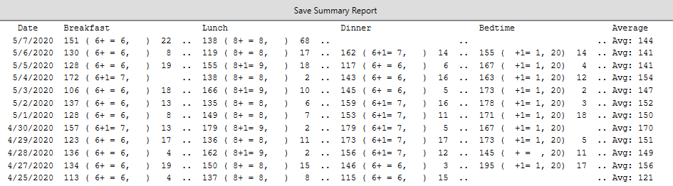
Reports Application
This application generates text files for the two types of reports available.
Log report – This shows all entries, organized by date and entry type.
Summary Report – This report shows a summary where each row has the various entries made, in a concise form.

